Slide 1
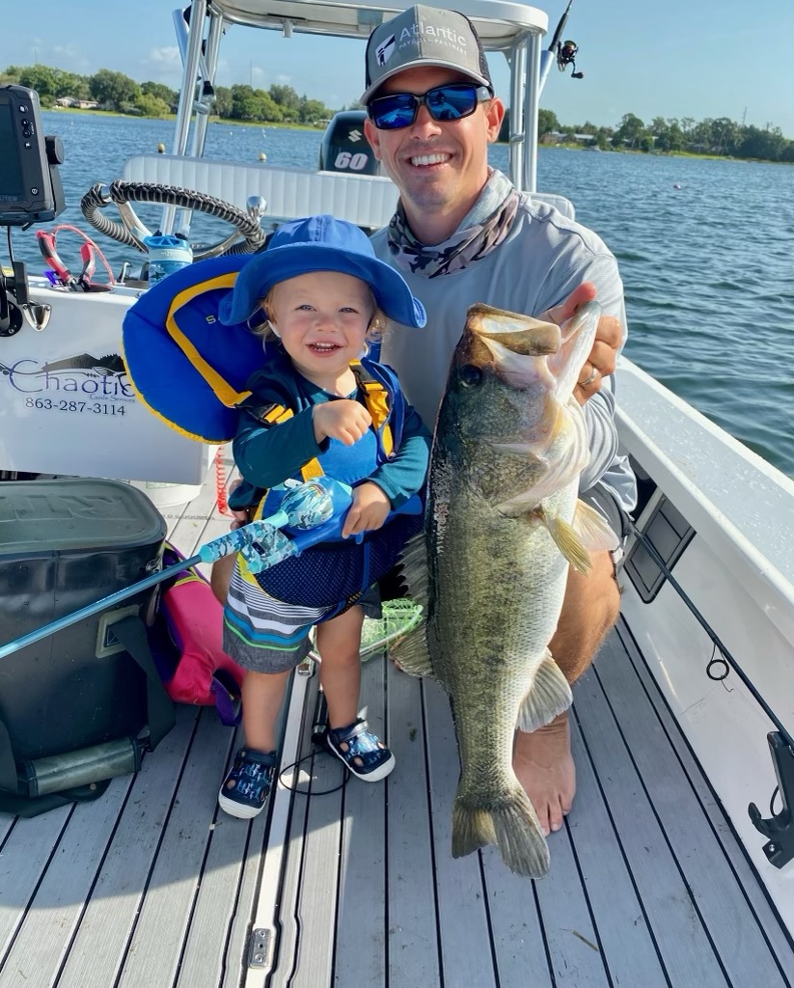
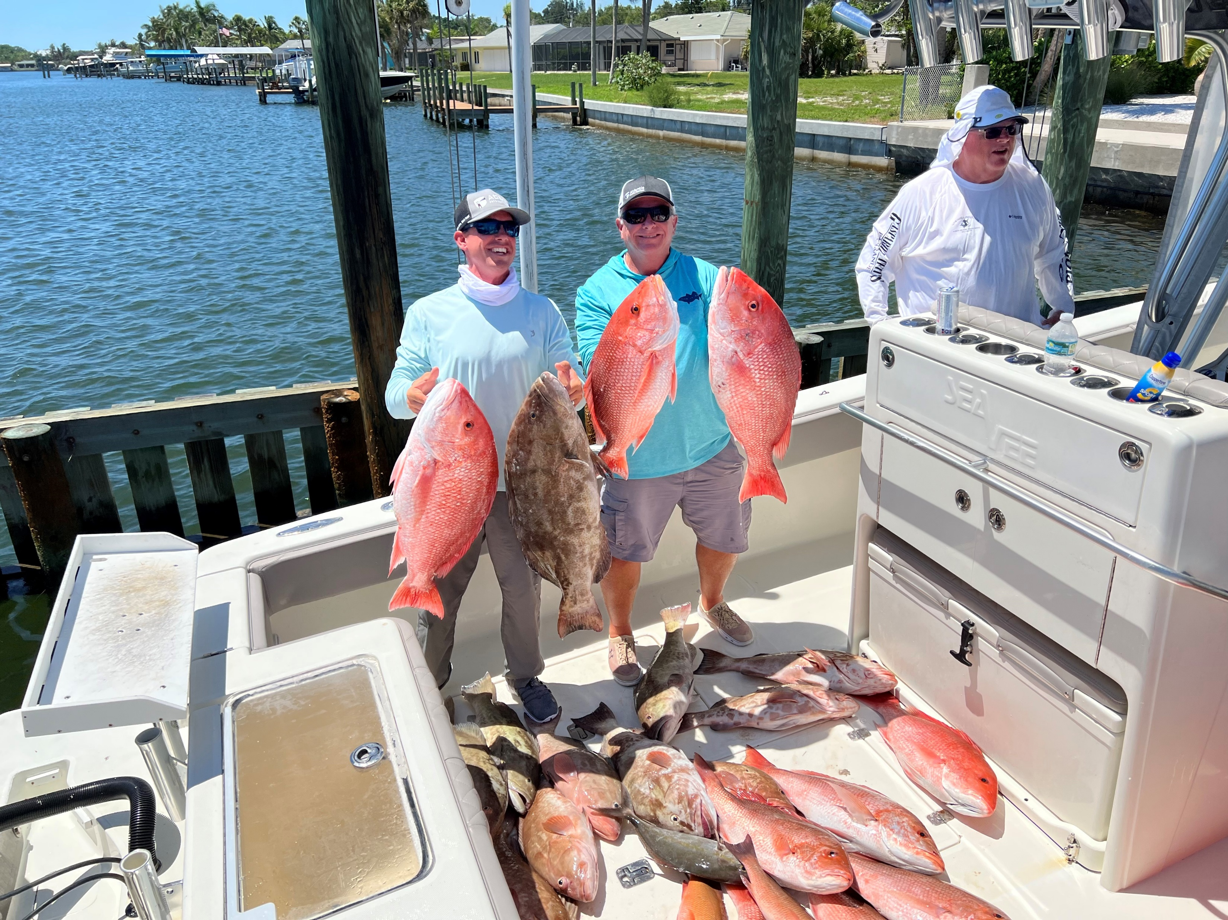
Crews Banking and Trust
2023 Live Training

Slide 2
Agenda
Atlantic Payroll Partners page 3
What’s a PEO? Page 4
Comparing a PEO to a Payroll Company page 5
Atlantic Payroll Partners Solutions page 6
Benefits of Atlantic Payroll Partners page 7
Paycard page 8
E-Verify and the Form I-9 page 9
3 Tactics to help businesses page 10
Appendix page 12
For two years in a row, Atlantic Payroll Partners has won Best of the Best for our services.

Slide 3
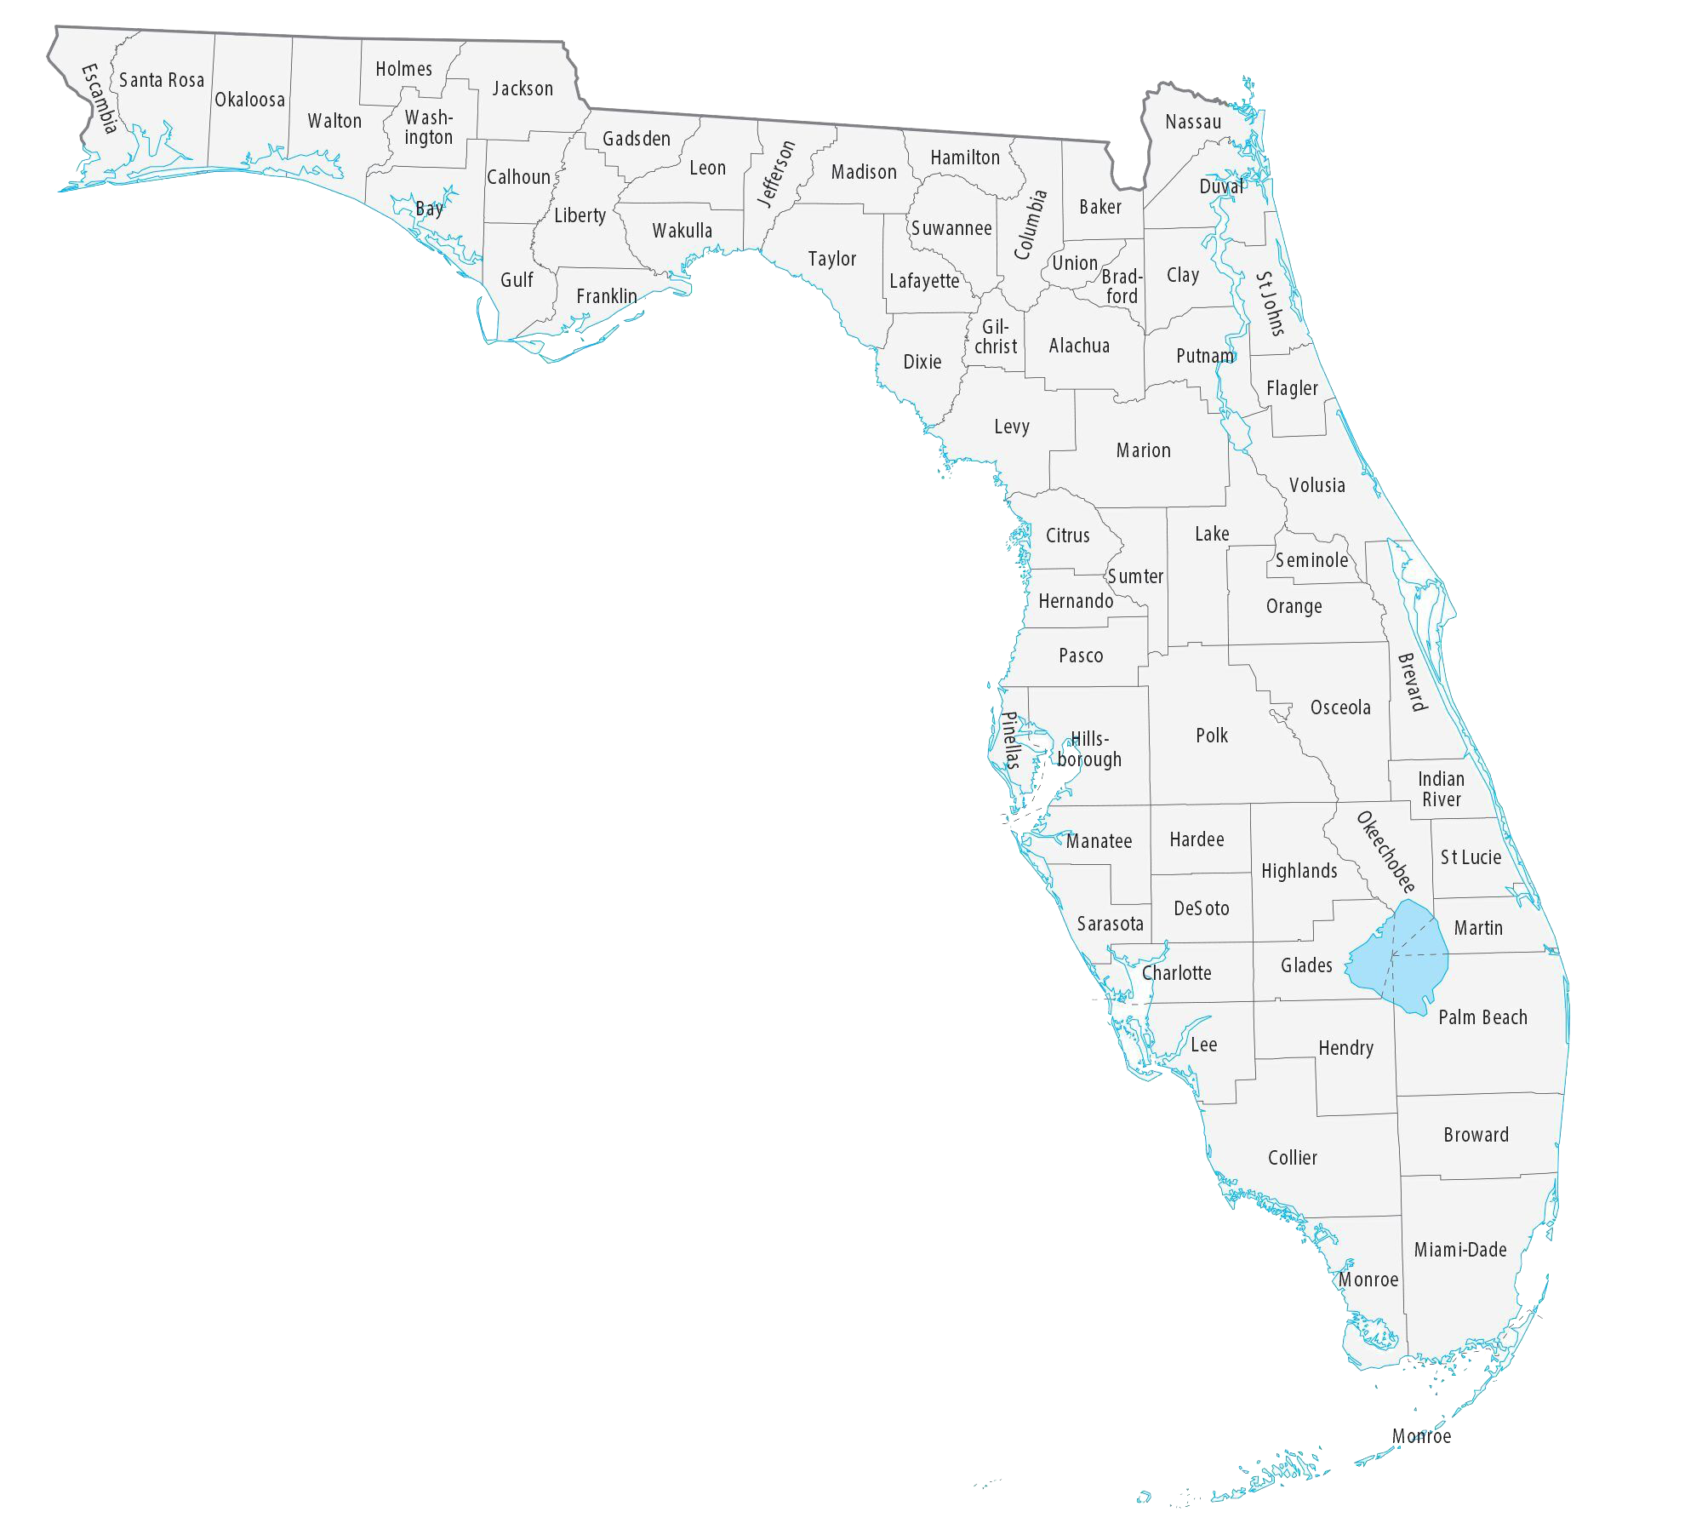
Atlantic Payroll Partners
2011 Intercoastal Payroll Solutions
was formed to offer accounting clients a solution for payroll and workers’ comp insurance.
2018 IPS became Atlantic Payroll Partners
This brand refresh allowed for continued growth, brand recognition, and uniformity between our locations in Winter Haven and Fort Pierce.
2021 Atlantic Payroll Partners wins
With the support of clients APP was able to capture its first Best of Best award.
Winter Haven
Bradenton
HQ Fort Pierce
2022 Atlantic Payroll Partners moves West
Our third location was opened in Bradenton, Florida. Increasing our reach and allowing us to better serve the State.
2023 Winter Haven makeover
To better support our clients were getting an office downtown!

Slide 4
You mentioned that you’re a PEO… What’s a PEO?
A professional employer organization (PEO) provides comprehensive HR solutions for small and mid-size businesses. Payroll, benefits, HR, tax administration, and regulatory compliance assistance are some of the many services PEOs provide to growing businesses across the country.
Small businesses that work with a PEO grow 7 to 9 percent faster, have employee turnover that is 10 to 14 percent lower, and are 50 percent less likely to go out of business.
Increase time to focus on Business
Better Employee Retention with Benefit Offerings
Bulk Purchasing Power for W/C and Benefits
Risk Mitigation
Improved Government Compliance
Reduced Cost
Centralization & Standardization

Slide 5
What if someone already has a payroll solution?
Compare their payroll solutions to that of a PEO?
Payroll
Tax Reporting & Compliance
Time & Attendance
HR Support
Payroll
401k and Retirement Plans
Sec 125, FSA and Cafeteria Plans
EPLI
HR Management & Compliance
Workers’ Comp and Risk Management
Benefits & Benefits Administration
Tax Reporting & Compliance

Slide 6
Our Solutions
Payroll
We accurately process payroll for businesses of all sizes, everyday.
Workers’ Comp
Protect your employees and your business with workers’ comp.
Forgo audits with our Pay-as-you-go solution.
HR
Worried about new rules and regulations? We’ll keep you up to date and decrease your risk.
Have a question? Give us a call and we’ll let you know how to proceed with an employee in a variety of situations.
We offer time clocks and paycards to better serve our clients.
Enjoy access to all your payroll related information through our online portal.
If someone gets hurt, WE handle the admin work.
Benefits
It’s all about the BENEFITS and offering them helps attract talented employees.
We offer health, dental, and vision insurance. As well as 401Ks to help your employees save for their future.
Accounting
You can count on us and more puns like this.
We offer business accounting services to compliment your overall experience with Atlantic Payroll Partners.
Onboarding
No one wants to deal with a bunch of paperwork.
Our electronic onboarding make work with us easy and improve accuracy.

Slide 7
Benefits
Save Time
Admin can easily take 2-3 hours of time per day. Unforeseen problems such as computer glitches, power outages, and time off can increase the time you’re dedicating to payroll.
Reduce Liability
Calculating State, Federal and Local Payroll taxes are time consuming, and a mistake could be costly.
The IRS estimates that 40% of business end up owing payroll tax penalties every year. The penalties average $845/ employee.
Peace of Mind
While you’re busy running your business, leave the payroll to us. You don’t have to worry about making payroll mistakes, if you’re not doing the payroll.
We’ll keep up with the tax laws, withholdings, reporting and overtime rules.
No call centers, no queues, just a dedicated team here to work with you week in a week out.
We’re truly BIG enough to serve you, small enough to know you.

Slide 8
Benefits
What’s the value of an hour of their time?
How many hours are being spent on keeping track of employee hours?
Making sure employees are getting paid via pay cards, direct deposit, checks etc.
Keeping up with payroll regulations?
Onboarding new employees?
Making sure deductions are made for child support and alimony?
Keeping track of PTO?
Answering questions about the Form W-4?
Keeping up with the rules surrounding the PPP?
Running reports to apply for various loans?
Running reports in general?
Filing reports for the State of Federal government?
Processing W-2s and 1099’s?
This doesn’t even include cost of tangible items and software required handle payroll.
Save Money
Don’t think that your customer can afford payroll? How much are they spending on payroll related expenses on their own?

Slide 9
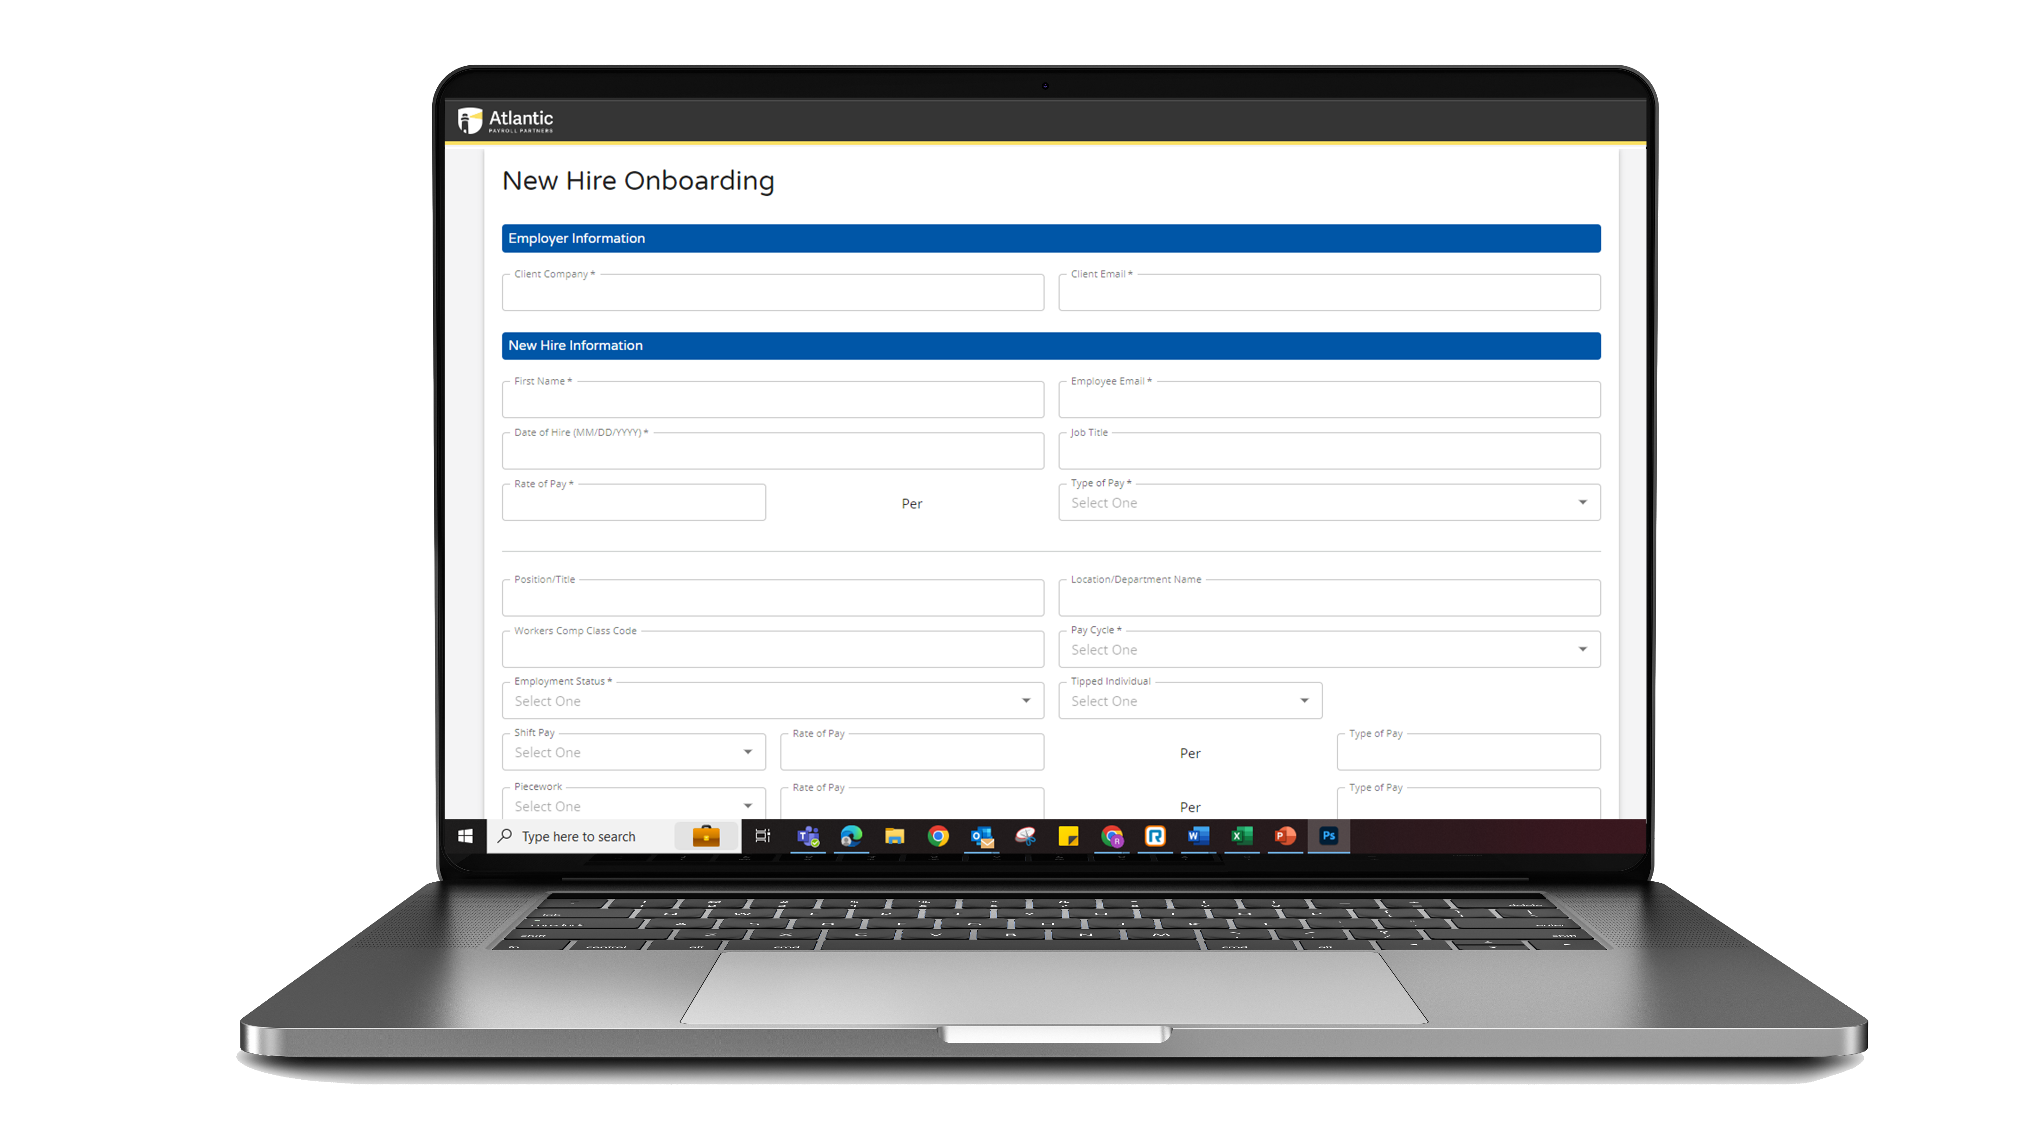
E-Verify & Form I-9
Atlantic Payroll Partners is uniquely positioned with the addition of our Onboarding Platform to provide support for businesses when it comes to E-Verification and the retention of IDs used to complete the Form I-9.
Our free Onboarding Solution allows employers to:
To get all new hire information acknowledged and signed electronically.
Digitally collect and retain copies of the IDs used to complete employment eligibility in the United States via the Form I-9.
The same documents acquired for the Form I-9 can be used to complete E-Verification.
The retention of the IDs used to complete the Form I-9 is required as of July 1st, 2023. The completion of the Form I-9 has been legally required by all businesses, regardless of size since 1986.
E-Verification for private businesses in Florida with 25 or more employees starts on July 1st as well.
Learn more at atlanticpayroll.us/e-verify

Slide 10
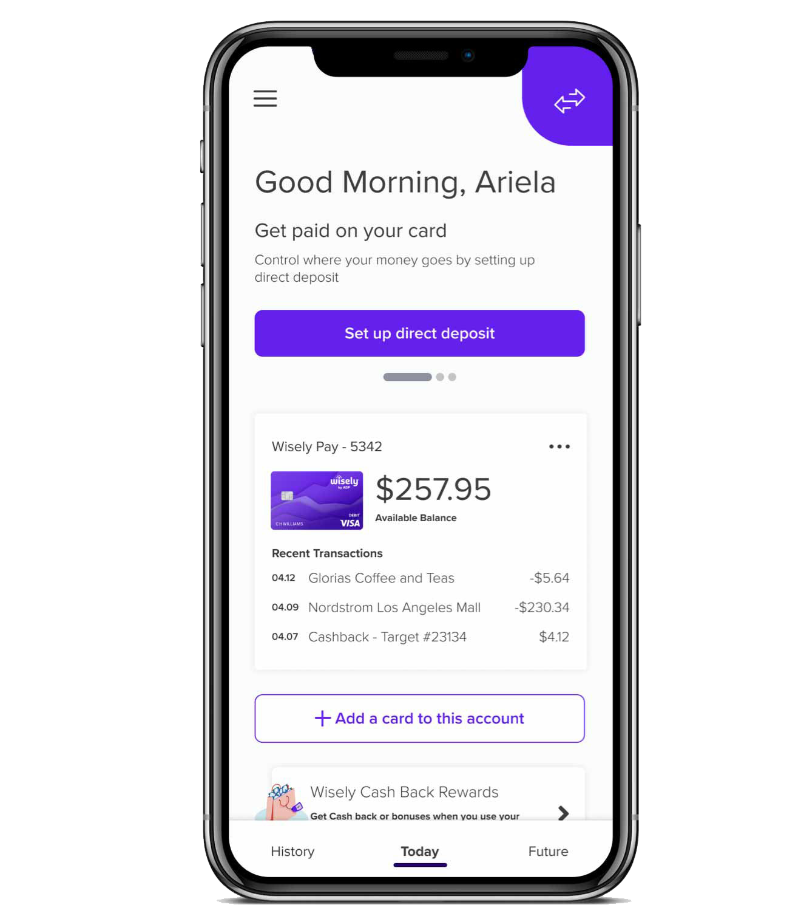
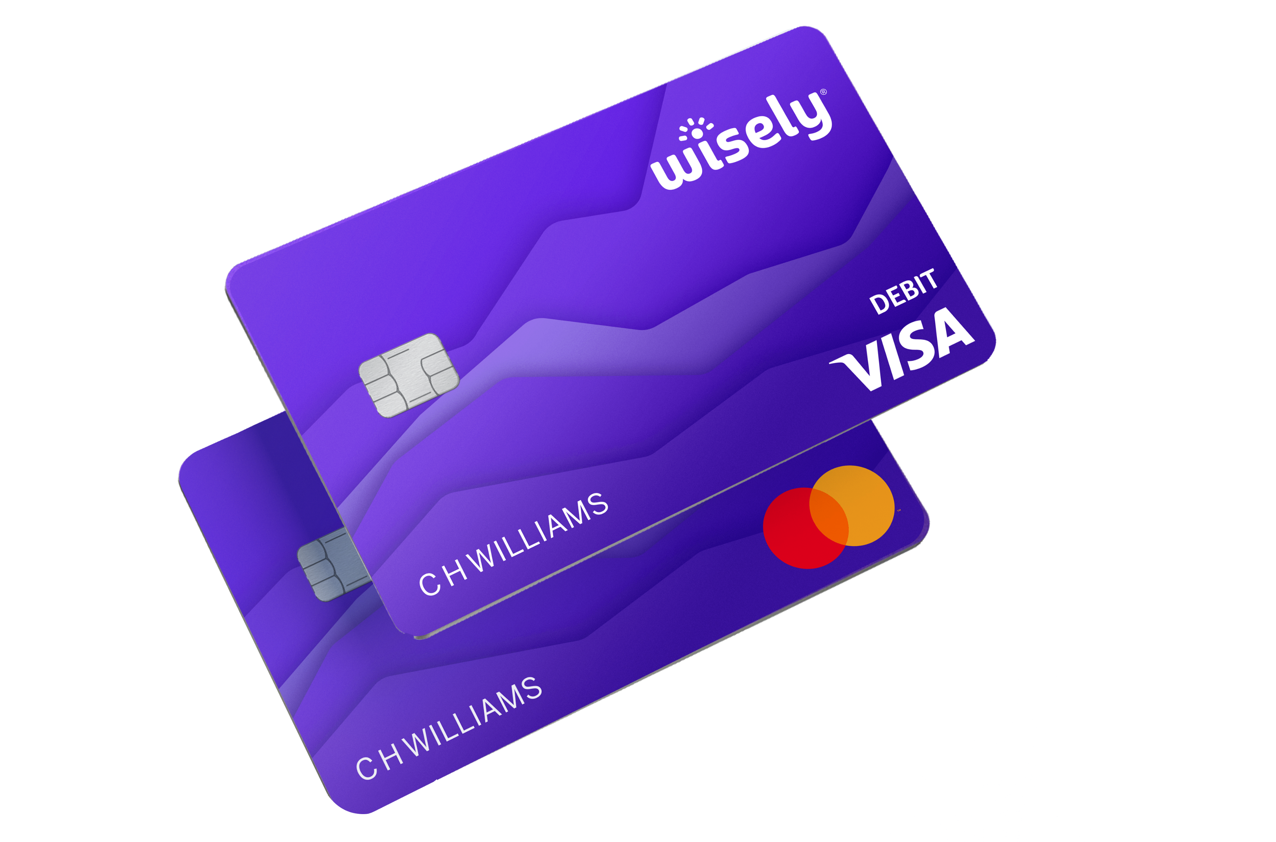
Get a Paycard
Sometimes our clients' employees are unbanked and a paycard is a solution to getting paid electronically.
Paycard Benefits
Access to Visa Debit Card without a Bank.
Get paid up to two days early.
Easy to use mobile app to track spending.
Ability to reload your card without using direct deposit.
No monthly fees.
No in network ATM fees.
Eliminated paper checks.

Slide 11
Multiple Solutions to Meet Various Needs
Payroll Only Solution
They can keep their current workers’ compensation coverage.
We would handle their payroll related needs.
Carve Out Solution
We handle their payroll needs.
We take care of the burdens involved with Workers’ Comp Insurance
Assist with Certificates
Audits
W/C Claims
Master Policy Solution
We handle payroll
Employees are under our master policy.
W/C is pay as you go.
No year end audits.
Those savings quickly add up.
*All clients must be approved for Workers Comp.

Slide 12
Appendix
Email sales@atlanticpayroll.us with questions
or call 772-466-0440.
Check out atlanticpayroll.us/blog to stay up to date on the latest.
To send a referral visit atlanticpayroll.us/crews

